Slide 1



Paper ID: 10 Optimizing Intelligent Traffic Management for Smart Cities Using Ensemble Learning Algorithms
Ateeq Ur Rehman Butt
Department of Computer Science
National Textile University, Faisalabad, Pakistan
3rd International Conference on Computational Intelligent Systems 2024
(ICCIS2024)

Slide 2
Contents
Introduction
Motivations
Novel Contributions
Proposed Methodology
Experimental Results
Conclusion

Slide 3
Introduction
Rapid urban population growth and increased motor traffic lead to congestion, economic losses, and environmental issues in cities.
Smart cities and IoT integration provide new opportunities for efficient traffic management.
IoT advancements, affordable sensors, and wireless networks support innovations in smart transportation and infrastructure.
Infrastructure gaps in developing countries create unique challenges, impacting congestion management and emergency response.
Big data analytics and ICT infrastructure (e.g., broadband, sensors) enable adaptive, real-time urban services for traffic, healthcare, and environmental monitoring.
Machine learning methods (e.g., traffic classification, data mining) enhance traffic pattern predictions, particularly within Internet of Vehicles (IOV) frameworks.

Slide 4
Motivations & Contributions 0f the Study
Address limitations of existing traffic management systems and the urgent need to resolve growing urban traffic congestion.
Develop an optimized intelligent traffic management system using advanced machine learning algorithms for real-time congestion prediction and mitigation.
Leverage ensemble learning techniques, including CNN, LSTM, GBM, and Transformer models, to enhance prediction accuracy and efficiency.
Validate the proposed system’s effectiveness using a high-resolution traffic prediction dataset, demonstrating its advantages over traditional methods.
Improve traffic flow and reduce congestion, ultimately enhancing urban residents' quality of life.
Support scalable, smart city infrastructure with a robust solution that integrates seamlessly into intelligent transportation systems (ITS).

Slide 5
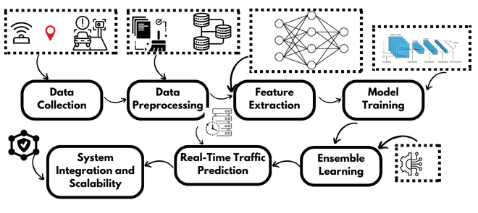
Proposed Methodology

Slide 6
Proposed System Architecture
Intelligent traffic management system designed for real-time traffic forecasting and congestion control.
The system includes components like data collection, preprocessing, feature extraction, model training, and ensemble learning.
Utilizes ensemble learning with CNN, LSTM, GBM, and Transformer models to enhance traffic prediction accuracy.
Workflow incorporates high-resolution traffic data from IoT sensors, GPS, traffic cameras, and historical records.
Ensemble model combining CNN, LSTM, GBM, and Transformer models.
CNN: Analyzes spatial patterns in traffic images and sensor data.
LSTM: Captures sequential dependencies for accurate predictions.
GBM: Boosts accuracy by combining weak learners.
Transformer: Manages complex interactions and long-range dependencies.

Slide 7
Implementation Details
Frameworks: TensorFlow, Keras, Scikit-learn, Hugging Face Transformers.
Hardware: NVIDIA GeForce RTX 2080 Ti GPU, 64GB RAM, Intel Core i9 processor.
Hyperparameters: 100 epochs, batch size of 64, learning rate of 0.001 with Adam optimizer.
Training: 80% of data for training, 20% for testing, with 5-fold cross-validation.

Slide 8
Experimental Results
Evaluation conducted using the Traffic Prediction Dataset.
Models evaluated for accuracy, mean absolute error (MAE), and root mean squared error (RMSE).
Performance of each model:
CNN: 97.85% accuracy, 2.35 MAE, 3.12 RMSE
LSTM: 98.22% accuracy, 2.10 MAE, 2.88 RMSE
GBM: 97.65% accuracy, 2.40 MAE, 3.18 RMSE
Transformer: 98.50% accuracy, 1.95 MAE, 2.70 RMSE
Ensemble: 99.37% accuracy, 1.50 MAE, 2.32 RMSE (highest performing model)

Slide 9
Comparison with Conventional Methods
Comparison conducted with linear regression and ARIMA methods.
Results:
Linear Regression: 90.45% accuracy, 6.50 MAE, 8.20 RMSE
ARIMA: 92.85% accuracy, 5.80 MAE, 7.55 RMSE
Proposed Ensemble: Outperforms with 99.37% accuracy, 1.50 MAE, 2.32 RMSE

Slide 10
Conclusion
The ensemble learning-based traffic management system improves prediction accuracy (99.37%) and reduces errors (MAE, RMSE) for smart city applications.
Integration of CNN, LSTM, GBM, and Transformer models supports real-time traffic flow management and reduces urban congestion.
System scalability and robustness make it a viable solution for smart city infrastructure.
Future work includes testing in real-time conditions and integrating additional data sources (e.g., social media, weather).
Advances in adaptive and reinforcement learning could further enhance the system’s effectiveness in dynamic traffic environments.

Slide 11
Thank you

